Slide 1
<^> TRIFORCE <^>
CMPS 335
Spring 2012
Gabe Pike
Team 10
Other Team Member: Brandon Hinesley

Slide 2
Overview (What even is Triforce?)
- Remake of Tetris Attack (SNES/1996)
- "Trifoce" (reference to game mechanic)
- Division of work

Slide 3

1.1 Requirements Workflow

Slide 4
1.1.1 Initial Understanding
- The "client" wants a remake of the classic SNES game Tetris Attack (1996) with modern graphics.
- The core game mechanics must resemble the original game as well as possible.

Slide 5
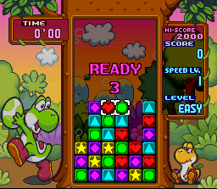
Core Mechanics: Play Area & Player
- The play area is filled with different blocks and empty spaces.
- The player controls a cursor and moves it one space at a time.
- The player can swap the currently selected blocks (horizontally).

Slide 6
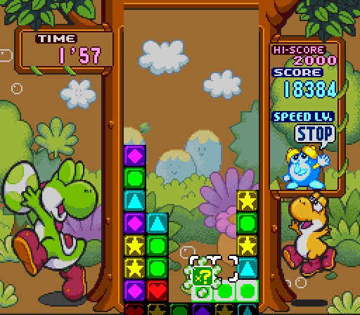
Core Mechanics: Combos
- Blocks gradually rise into the gameplay area from below.
- The player aligns 3 or more blocks to get a combo.
- A combo temporarily stops blocks from rising.
- The blocks in the combo disappear, or "clear" after a short period of time.

Slide 7
Core Mechanics: Chains
- Blocks above the combo will fall down until they land on another block.
- A chain occurs when the blocks above a cleared combo fall down into another combo.
- Chains are more difficult than combos to pull off (will be demonstrated later).

Slide 8
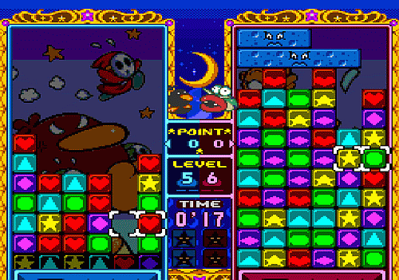
Core Mechanics: Modes of Play
- Difficulty
- Endurance Mode
- Versus Mode
- Winning/Losing

Slide 9
Input
- The game must support control with keyboard, mouse, and xbox controller.

Slide 10
Menu
- The player must initially be presented with a menu that has the following buttons:
- Play
- Help
- Quit

Slide 11
Non-functional Requirements
- Run on a Windows OS
- Programmed in C++
- Use OpenGL, GLUT, and 2DGraphics library

Slide 12
Glossary
Tetris Attack: An SNES game released in 1996, which Triforce is based off of.
Combo: Occurs when a player aligns three or more matching blocks.
Chain: Occurs when blocks that fell because of a cleared combo land into another combo.
Grid/Play Area: The collection of blocks, empty spaces, and cursor for a single player.

Slide 13
1.1.2 Initial Business Model
- The game will be a remake of the original Tetris Attack with updated graphics and sounds.
- It will support multiple input devices.
- Has a main menu.

Slide 14
Use Case Diagrams
Main Menu
User selects Play
Brief Description: When the user selects Play, the game objects are loaded and gameplay begins.

Slide 15
Use Case Diagrams
Main Menu
User selects Help
Brief Description: When the user selects Help, instructions on how to play are displayed.

Slide 16
Use Case Diagrams
Main Menu
User selects Quit
Brief Description: When the user selects Quit, the game immediately exits.

Slide 17
Use Case Diagrams
Anywhere in the game
User activates a registered input binding (keyboard, mouse, controller)
Brief Description: When the user activates a registered input binding, such as pressing/holding a key, clicking the mouse, or pressing a button on an xbox controller, its registered callback function is called.

Slide 18
Use Case Diagrams
Gameplay Area
User moves the cursor
Brief Description: When the user moves the cursor, the cursor's position is updated one block in the direction the user requests, and the graphic is redrawn.

Slide 19
Use Case Diagrams
Gameplay Area
User swaps blocks
Brief Description: When the user swaps the two blocks, the graphics and states of the selected blocks are swapped with each other.

Slide 20
Use Case Diagrams
Gameplay Area
User gets a combo
Brief Description: When the user gets a combo, blocks will temporarily stop rising. An animation is played, and then the blocks break. The blocks above the cleared combo will fall down.

Slide 21
Use Case Diagrams
Gameplay Area
User gets a chain
Brief Description: When the user gets a chain, it will act just like a regular combo. However, a bonus will be displayed to indicate that a chain occurred.

Slide 22
Use Case Diagrams
Gameplay Area
User increases the speed of blocks rising
Brief Description: The user can activate a key binding that forces blocks to rise at a faster rate. This rate will be constant, and the current speed will be temporarily replaced with this constant while the binding is activated.

Slide 23
Use Case Diagrams
Gameplay Area
User loses the game
Brief Description: The user loses the game when a block hits the top of the grid.

Slide 24
1.1.3 Obtain Initial Requirements
The user begins the game and is presented with the main menu. The options are Play, Help, and Quit. The user begins the game by selecting Play. A tutorial is displayed if he selects Help. The game exits if he selects Quit. The game must support multiple input devices, so multiple bindings must map to a single action.
The user has a limited amount of actions. While in game, the user can:
- move in the cursor up, down, left, and right
- temporarily increase the speed that blocks rise into the play area
- swap blocks
When the user swaps blocks, it has a possibility of causing a combo, thus changing the state of the game.

Slide 25
1.1.4 Obtain Detailed Requirements
Input:
- Since multiple input devices must be supported, a generic interface must be able to handle all of them.
- Different states must be recognized, such as when a binding is pressed, held down, and released.
- More details in Brandon's presentation.

Slide 26
1.1.4 Obtain Detailed Requirements
Game Mechanics:
- The cursor moves one space at a time.
- The cursor cannot move outside of the grid.
- When a block comes into contact with the top of the grid, the player loses the game.
- A timer will keep track of the time played and be displayed on the screen.
- The score will be displayed on the screen.

Slide 27
1.1.4 Obtain Detailed Requirements
Game Mechanics:
- Chains must be kept track of between combos and fall events.
- At least 3 blocks form a combo, but it is possible to have up to 14 in a single combo.
- After a combo clears, an algorithm must detect which blocks need to fall down.
- When a falling block lands, an algorithm must detect if a combo occurs.

Slide 28
1.1.4 Obtain Detailed Requirements
Game Mechanics:
- When a combo >=4 or a chain occurs, it shall display an animated bonus where the event happened.
- Combos will multiply the number of blocks in the combo by a constant and add it to the score.
- Chains will act as multipliers to the combo that occurs and drastically increase the score.

Slide 29
1.1.5 Iterated Use-Case Diagrams
Main Menu
User selects Play
Updated Description: When the user selects Play, the game state is changed. The grid, cursor, blocks, timer, and score are initialized.
Step-by-step:
1. User selects Play
2. Change game state to PLAY
3. Initialize grid, cursor, blocks, timer, and score

Slide 30
1.1.5 Iterated Use-Case Diagrams
Main Menu
User selects Help
Updated Description: When the user selects Help, instructions on how to play are displayed.
Step-by-step:
1. User selects Help
2. Display text/graphics at the correct position that explain how to play.

Slide 31
1.1.5 Iterated Use-Case Diagrams
Main Menu
User selects Quit
Updated Description: When the user selects Quit, the game immediately exits.
Step-by-step:
1. User selects Quit
2. Game exits

Slide 32
1.1.5 Iterated Use-Case Diagrams
Anywhere in the game
User activates a registered input binding (keyboard, mouse, controller)
Updated Description: When the user activates a registered input binding, and the binding is in a registered state (e.g. on_press, is_down, _on_release), its registered callback method is invoked.
Step-by-step:
1. Map a keybinding to an action and an input state
2. User activates keybinding
3. Callback method is invoked

Slide 33
1.1.5 Iterated Use-Case Diagrams
Gameplay Area
User moves the cursor
Updated Description: When the user moves the cursor, the cursor's position is updated one block in the direction the user requests, and the graphic is redrawn.
Step-by-step:
1. User input calls cursor move method.
2. Calculate cursor's new coordinates based on the direction it is moved.
3. Do not let cursor escape bounds of grid.
4. Redraw the cursor.

Slide 34
1.1.5 Iterated Use-Case Diagrams
Gameplay Area
User swaps blocks
Updated Description: When the user swaps the two blocks, the graphics and states of the selected blocks are swapped with each other. Combo detection and fall detection algorithms are executed.
1. User input calls swap block method.
2. The graphics and states of the selected blocks are swapped with each other.
3. Detect combos for both blocks.
4. Detect falls for both blocks

Slide 35
1.1.5 Iterated Use-Case Diagrams
Gameplay Area
User gets a combo
Updated Description: When the user gets a combo, the blocks in the combo go into a combo state. All blocks will temporarily stop rising. A combo with 4 or more blocks displays a bonus animation. The blocks in the combo display a special effect. Detect if any blocks need to fall.
1. Combo is detected
2. Set state of Blocks in the combo to COMBO and state of Grid to COMBO
3. Display animated bonus if combo has 4 or more blocks in it.
4. Display different graphic while blocks are in COMBO state and pause the rising of new blocks while grid is in COMBO state
5. After time for combo has elapsed, set state of blocks in combo to DISABLED, and Grid state to PLAY
6. Detect blocks that need to fall

Slide 36
1.1.5 Iterated Use-Case Diagrams
Gameplay Area
User gets a chain
Updated Description: When the user gets a chain, it will act just like a regular combo. However, a bonus will be displayed to indicate that a chain occurred.
Step-by-step:
Same as combo, except for step 3.
3. Display animated bonus if combo has 4 or more blocks in it, and display an animated bonus for the chain.

Slide 37
1.1.5 Iterated Use-Case Diagrams
Gameplay Area
User increases the speed of blocks rising
Updated Description: The user can activate a key binding that forces blocks to rise at a faster rate. This rate will be constant, and the current speed will be temporarily replaced with this constant while the binding is activated.
1. User input invokes method to make blocks rise faster.
2. Grid's state changed to PUSH
- while in PUSH state, automatic rising of blocks is disabled.
3. Blocks are pushed up by 1 pixel on a short, constant interval while the input binding is active.
4. When user releases the button, the Grid's state is changed to PLAY.

Slide 38
1.1.5 Iterated Use-Case Diagrams
Gameplay Area
User loses the game
Brief Description: The user loses the game when a block hits the top of the grid.
1. Block hitting the top of the Grid is detected.
2. Grid state changes to GAMEOVER.
- While in GAMEOVER state, blocks stop pushing up.
3. Initialize a countdown timer.
4. Display graphics for game over screen.
5. Go back to main menu.

Slide 39
Final Use Case Diagram
User Input
Select Play
Move cursor
Swap blocks
Get combo
Get chain
Select Help
Push blocks
Select Quit
Lose Game

Slide 40
1.2 Walkthrough
The walkthrough revealed:
- Use-case diagrams were drawn incorrectly
- Did not need use-case for starting the game
- Remove use-cases for selecting Settings and About buttons, since we are not going to implement them.

Slide 41
1.3 Revised Analysis Workflow
All problems noted in walkthrough have been fixed and were already shown in section 1.1.

Slide 42

2.1 Analysis Workflow

Slide 43
2.1.1 Function Modeling
Normal Scenarios
Scenario 1:
1. Player selects Play
2. Change game's stay to PLAY
3. Initialize the Grid with randomized blocks, and initialize the timer and score.

Slide 44
2.1.1 Function Modeling
Normal Scenarios
Scenario 2:
1. Player selects Help
2. Display a helpful guide for how to play
3. Display a button to go back

Slide 45
2.1.1 Function Modeling
Normal Scenarios
Scenario 3:
1. Player selects Quit
2. Immediately exit the game

Slide 46
2.1.1 Function Modeling
Normal Scenarios
Scenario 4:
1. Player moves cursor
2. Cursor's position is recalculated based on the direction it is moved
3. Cursor is redrawn

Slide 47
2.1.1 Function Modeling
Normal Scenarios
Scenario 5:
1. Player swap blocks
2. The selected blocks are swapped with each other
3. Detect combos for each block
4. If combo is detected, goto combo detected scenario
5. Detect fall for each block
6. If fall is detected, goto fall detected scenario

Slide 48
2.1.1 Function Modeling
Normal Scenarios
Scenario 6:
1. A combo is detected
2. Increment the chain count for the combo
3. If combo has 4 or more blocks, display an animated bonus with the number of blocks in it
4. Set state of Grid and Blocks in the combo to COMBO
5. Remain in the COMBO state for (N number of blocks * T milliseconds)
6. Set the state of the COMBO blocks to DISABLED when the timer elapses, and set Grid's state to PLAY
7. Detect falling blocks
8. Group all falling blocks in the same fall event, and goto scenario for detecting a fall event

Slide 49
2.1.1 Function Modeling
Normal Scenarios
Scenario 7:
1. A fall event is detected
2. Set all the blocks in the fall event to the FALL state
3. For each block, fall Y pixels every T milliseconds while in the FALL state
4. Set block's state to ENABLED when it lands in a cell above another enabled block.
5. Detect combo for each falling block
6. If combo is detected, goto combo detected scenario

Slide 50
2.1.1 Function Modeling
Normal Scenarios
Scenario 8:
1. Player input requests to push blocks up faster
2. Grid set to PUSH state
3. Automatic block rising is temporarily disabled
4. Blocks are pushed up every T milliseconds, an interval less than the automatic interval
5. Grid restored to PLAY state when input binding is no longer active

Slide 51
2.1.1 Function Modeling
Normal Scenarios
Scenario 9:
1. A block comes into contact with the top of the Grid
2. Game set to GAMEOVER state for T milliseconds
3. Game over graphic displayed on screen while in GAMEOVER state, and player controls are disabled
4. Go back to main menu when timer elapses

Slide 52
2.1.1 Function Modeling
Exception Scenarios
Scenario 1:
1. Player sends input that is not a registered binding
2. Nothing happens

Slide 53
Identification of Nouns
When the game loads, the player is presented with the main menu. The player can select buttons that take actions when selected. The buttons on the main menu are Play, Help, and Quit. The Help menu displays explains how to play the game. The Quit button closes the game. The player clicks the Play button and to start the game.
The game play consists of a grid for each player. A grid contains blocks and a cursor. The player controls the cursor and can use it to swap blocks. If at least 3 blocks are lined up, a combo event occurs. If there are disabled blocks under an enabled block, then a fall event occurs. A fall event can only occur after the player swaps blocks or after a combo event. A combo event can only occur after the player swaps or after a fall event. The grid is responsible for detecting combo events and fall events. An animated bonus is displayed when the player gets a big combo or a chain. A heads-up display (HUD) displays a timer and the score.
Input devices all go through a single input controller that controls the flow of execution based on the current state of the game and the action bound to the input event.

Slide 54
Noun Extraction
player, menu, button, actions, grid, block, cursor, combo event, fall event, bonus, HUD, timer, score, input device, input controller, state

Slide 55
2.1.2 Entity Class Modeling
Noun Extraction
button, block, cursor, combo event, fall event, bonus, HUD, timer, score

Slide 56
2.1.2 Entity Class Modeling
Attribute Box Diagram
HUD
x, y (int)
startTime, curTime (long)
seconds, minutes (int)
score (int)
Bonus
bonusType (enum)
column, row (int)
speed, interval (int)
x, y, offset (int)
text (CObject)
lastMove, totalMove (int)
FallEvent
fallsNodes (FallNode[])
chainCount (int)
Block
state (enum)
currentFrame (int)
x, y (int)
fallOffset, fallSpeed (int)
ComboEvent
state (enum)
down, up, left, right, mid (Cell(x, y))
chainCount (int)
interval (int)
startTime (long)
FallNode
chainCount (int)
enabled (bool)
lastFall (long)
numBlocks(int)
Cursor
currentFrame (int)
x, y (int)
row, column (int)

Slide 57
2.1.2 Entity Class Modeling
UML Box Diagram
HUD
Bonus
FallEvent
ComboEvent
FallNode
Block
Cursor

Slide 58
2.1.3 Boundary Class Modeling
Noun Extraction
button, player, input, input device, action

Slide 59
2.1.3 Boundary Class Modeling
Attribute Box Diagram
Button
state (enum)
currentFrame (int)
x, y (int)
action (Action)
Input
actions (Action[])
players (Player[])
input devices
keybindings
...

Slide 60
2.1.3 Boundary Class Modeling
UML Box Diagram
Button
Input
Action

Slide 61
2.1.4 Control Class Modeling
Noun Extraction
game, game play, grid

Slide 62
2.1.4 Control Class Modeling
Attribute Box Diagram
Game
state (enum)
gamePlay (GamePlay)
buttons (Button)
Grid
state (enum)
blocks (Block[][])
cursor (Cursor)
comboEvents (Combo[])
fallEvents (Fall[])
bonusEvents (Bonus[])
difficulty (enum)
x, y (int)
pushOffset, pushInterval (int)
pushAccelDelta, pushAccelInterval (int)
startPushIntervals, endPushIntervals (int[])
GamePlay
game files (strings)
sprites (CBaseSprite)
grid (Grid)
hud (HUD)
state (enum)

Slide 63
2.1.4 Control Class Modeling
UML Box Diagram
Game
GamePlay
Grid

Slide 64
2.1.5 Dynamic Modeling
Start
End
Main Event Loop
Player loses game
Play button pressed
Help button pressed
Player moves cursor
Player swaps blocks
Quit button pressed
Process Request
switch to PLAY state
Process request
display tutorial
Process request
move cursor in requested direction
Process request
swap selected block objects
Player pushes blocks
Process combo
set grid and blocks to combo state
spawn bonus
Combo detected
Detect combos
run combo detection algorithm
Process request
set grid to PUSH state
Process fall
set blocks to fall state
Fall detected
Detect falls
run fall detection algorithm
End the game play
switch to GAMEOVER state

Slide 65
2.1.6 Communication Modeling
Call button's action
Button
Action
Input
Do action
Do action
Do something based on input
Game
Game Play
Grid
Initialize GamePlay when user selects Play
Initialize Grid(s) and control it based on state
Update score/timer
Create and update fall events
HUD
Update cursor position
Cursor
Create and update combos
Fall Event
Create blocks and update their positions and states
Create and update bonuses
ComboEvent
Update fall nodes
Block
Bonus
Fall Node

Slide 66
2.2 Walkthrough
The walkthrough revealed:
- several models were done wrong and had to be redone from scratch
- functional model was all in one giant scenario; needs to be broken up
- not using UML conventions

Slide 67
2.3 Revised Analysis
All problems noted in walkthrough have been fixed and were already shown in section 2.1.

Slide 68
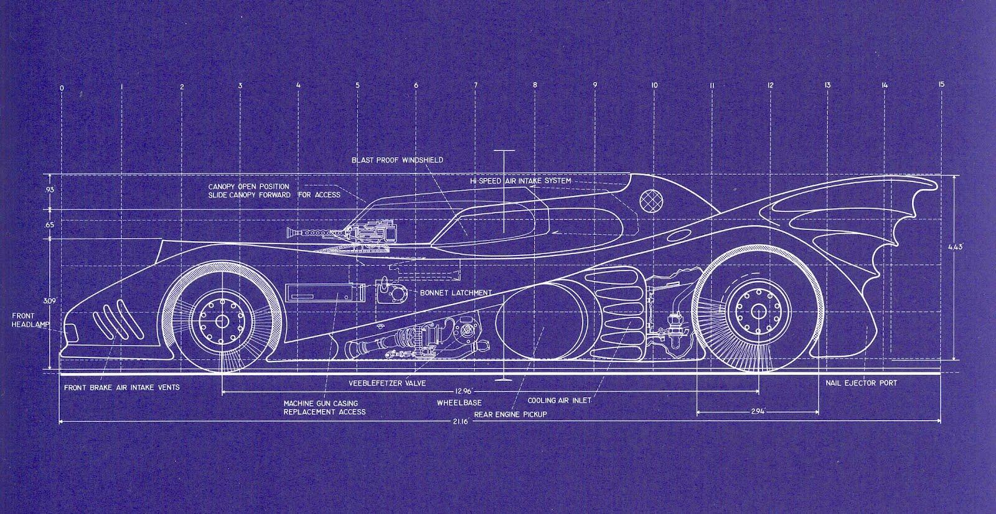
3.1 Design Workflow

Slide 69
3.1.1 Component Design
CRC Cards
Class: Game/Triforce
Responsibility:
Load the main menu
Control flow of the program based on the current state
Set up input bindings/handlers
Collaboration:
GamePlay
Input

Slide 70
3.1.1 Component Design
CRC Cards
Class: Input
Responsibility:
Provide an interface to bind input events to actions (callback methods)
Collaboration:
Triforce
GamePlay
Button
Grid
Cursor

Slide 71
3.1.1 Component Design
CRC Cards
Class: GamePlay
Responsibility:
Initialize the game
Handle input that affects the state of GamePlay
Control the flow among objects in GamePlay
Initialize objects that will be displayed during the game
Collaboration:
Grid
Input
HUD

Slide 72
3.1.1 Component Design
CRC Cards
Class: Grid
Responsibility:
Provide an interface to GamePlay for control the cursor
Update the Cursor's coordinates
Swap Blocks
Detect/Initialize Combos
Detect/Initialize Falling Events
Initialize Bonuses
Keep track of all events and update them for each iteration of the main loop
Call display methods for all of Grid's objects that must be displayed
Update score
Collaboration:
Cursor
Block
Combo
Fall
Bonus
Input

Slide 73
3.1.1 Component Design
CRC Cards
Class: Cursor
Responsibility:
Draw itself
Provide methods to move the cursor
Keep track of position
Collaboration:
Input
Grid

Slide 74
3.1.1 Component Design
CRC Cards
Class: Block
Responsibility:
Display itself
Provide methods for swapping Blocks
Provide methods for falling down
Collaboration:
Grid
Combo
FallNode

Slide 75
3.1.1 Component Design
CRC Cards
Class: Combo
Responsibility:
Provide an interface to Grid for managing combo events
Update the state of the Combo
Update the Grid's state based on the state of the Combo
Keep track of chains
Detect fall events when the combo has elapsed
Collaboration:
Grid
Block
Fall

Slide 76
3.1.1 Component Design
CRC Cards
Class: Fall
Responsibility:
Provide an interface to Grid for managing fall events
Update the state of the fall
Manage individual FallNodes, calling their update functions for every iteration of a Fall
Keep track of chains
Detect combo events when the fall has elapsed
Collaboration:
Grid
Block
Combo
FallNode

Slide 77
3.1.1 Component Design
CRC Cards
Class: FallNode
Responsibility:
Provide an interface to Fall for managing a single list column of falling blocks
Update state of FallNode
Keep track of position and number of Blocks in the fall
Cause Blocks to fall for each iteration
Collaboration:
Fall
Grid
Block

Slide 78
3.1.1 Component Design
CRC Cards
Class: HUD
Responsibility:
Display the score
Keep track of and display the time
Collaboration:
GamePlay
Grid

Slide 79
3.1.1 Component Design
CRC Cards
Class: Button
Responsibility:
Display itself based on current state
Register and call callback functions when pressed
Collaboration:
Game
GamePlay
Action

Slide 80
3.1.2 Interface Design
Interface Actions | Interface Objects | User Actions (events)
display() | Calls display() methods for each class, starting at the base and branching out in a tree fashion. Every object that is actually displayed calls its own draw() function with the current frame as the argument. | User activates a registered input binding to call display() and update the screen after the action is taken.
composeFrame() | Updates the state and coordinates of game objects based on the current state of the object. Called in a tree-like fashion, like display(). | none
swapBlocks() | Swaps the blocks that the cursor currently has selected and updates the display. | User activates the registered input binding for swapping blocks.
selectButton() | Calls the action that is registered for an instance of a specific button | User selects a button

Slide 81
3.1.2 Interface Design
Interface Actions | Interface Objects | User Actions (events)
moveCursor() | Moves the cursor to the requested position. The cursor must follow the mouse, but if not using the mouse it will move one block at a time. | User activates the registered input binding for moving blocks.
pushRow() | Pushes a new row of blocks onto the Grid. | Called while the Grid is in the Play state, or when the user activates the registered input binding for pushing new rows. When a user pushes a new row, it is pushed faster than the passive speed.
pause() | Calls the action that is registered for an instance of a specific button | User selects a button

Slide 82
3.1.3 Architectural Design
Call and Return Architecture
Input
Display
Game
Buttons
GamePlay
HUD
Grids
Buttons
Cursor
Blocks
Falls
Combos
Bonuses
FallNodes

Slide 83
3.1.4 Detailed Class Design
Tabular Detailed Design
Class name | Grid
Method name | detectCombo
Return type | Combo
Input arguments | Cell & cell, int chains, bool doBonus
Output arguments | None
Error messages | None
Files accessed | None
Files changed | None
Methods invoked | Grid:: matchUp, matchDown, matchLeft, matchRight Combo::changeState Combo::init Grid::initBonus
Narrative | Method detectCombo takes a pair of coordinates in a Cell class, and the number of chains from the last fall (if any), and detects if a combo occured at that point. If doBonus is true, it will spawn a bonus animation if a big combo or chain is detected.

Slide 84
3.1.4 Detailed Class Design
PDL's
int Grid::detectCombo(Cell &cell, int chains, bool doBonus) {
Combo combo(chains);
detect left and right matches from given cell (horizontal match)
if (horizontal match >= minimum combo size) {
Store left and right coordinates in the combo object
for each coordinate, horizontally from left to right {
detect down and up matches (vertical match)
if (vertical match >= minimum combo size) {
store up and down coordinates in combo
set combo state to MULTI
initialize combo
if (doBonus)
initialize bonus
}
}
set combo state to HORIZONTAL
initialize combo
if (doBonus)
initialize bonus
return combo
}

Slide 85
3.1.4 Detailed Class Design
PDL's
else {
detect down and up matches from given cell (vertical match)
if (vertical match >= minimum combo size) {
store up and down coordinates in combo
for each coordinate, vertically from bottom to top {
detect horizontal matches from each coordinate (horizontal combo)
if (horizontal match >= minimum combo size) {
store left and right coordinates in combo
set combo state to MULTI
initialize combo
if (doBonus)
initialize bonus
}
}
set combo state to VERT
initialize combo
if (doBonus) initialize bonus
}
else {
set combo state to NONE
return combo;
}
}
}

Slide 86
3.1.4 Detailed Class Design
Tabular Detailed Design
Class name | Grid
Method name | detectFall
Return type | bool
Input arguments | int row, int column, bool initialize
Output arguments | None
Error messages | None
Files accessed | None
Files changed | None
Methods invoked | Block::getState, Combo::getState Fall::Fall
Narrative | Method detectFall detects a fall from a given set a coordinates. It will initialize the fall as well if initialize is true.

Slide 87
3.1.4 Detailed Class Design
PDL's
bool Grid::detectFall(int row, int col, bool initialize) {
if row > maximum row or row < 0
return false;
Block::gameState midState, downState;
downState = blocks[r-1][c].getState();
midState = blocks[r][c].getState();
if (downstate is DISABLED or FALL and midstate is ENABLED) {
if (initialize) {
Fall fall(FallNode(r, c));
initialize fall
push fall onto fallEvents list
}
return true;
}
else return false;
}

Slide 88
3.1.4 Detailed Class Design
Tabular Detailed Design
Class name | Grid
Method name | detectFall
Return type | bool
Input arguments | Combo &
Output arguments | None
Error messages | None
Files accessed | None
Files changed | None
Methods invoked | Block::getState, Combo::getState Grid::detectFall(int, int, bool) Fall::Fall
Narrative | Method detectFall detects a fall for all blocks in a given combo.

Slide 89
3.1.4 Detailed Class Design
PDL's
bool Grid::detectFall(const Combo &combo) {
Fall fall(combo.chainCount())
foreach (coordinate in the combo) {
if (detectFall(row, col, false)) {
set the fall type based on the combo type
push FallNode onto Fall
}
}
if (there was a fall) {
fall.possibleChain = true;
initialize fall
push fall onto list of Fall events
return true;
}
else return false
}

Slide 90
3.1.4 Detailed Class Design
Tabular Detailed Design
Class name | Grid
Method name | pushRow
Return type | void
Input arguments | None
Output arguments | None
Error messages | None
Files accessed | None
Files changed | None
Methods invoked | Cursor::offsetY, Block::offsetY cursor::shiftRow Grid::addRow
Narrative | Method pushRow updates the position of the blocks when a row needs to be pushed onto the gameplay area. The interval that rows push up decreases over time, but that is not controlled by composeFrame. The interval for force-pushing rows up is fixed.

Slide 91
3.1.4 Detailed Class Design
PDL's
void Grid::pushRow() {
pushOffset += speed;
cursor->offsetY(-speed);
foreach Block in the Grid
blocks[i][j].offsetY(-speed);
if (pushOffset >= blockLength) {
pushOffset %= blockLength;
cursor.shiftRow();
addRow();
}
}

Slide 92
3.2 Walkthrough
Walkthrough revealed that:
- CRC cards did not all accurately represent the way the classes were implemented
- Architectural design was done incorrectly and had to be done redone
- PDL's needed to be updated to the latest design

Slide 93
3.3 Revised Design
All problems noted in walkthrough have been fixed and were already shown in section 3.1.

Slide 94

4.1 Conclusion

Slide 95
4.1 Conclusion
What I have learned (the hard way)
- Software engineering is nontrivial
- Solve the problem before you write the code
- Documentation is no fun, but it is necessary for a maintainable product
- The earlier a mistake goes unnoticed, the worse it hurts you later on
- Sometimes rewriting from scratch is less expensive than refactoring
- VERSION CONTROL!

Slide 96
4.1 Conclusion
And now, the game!

